Slide 1



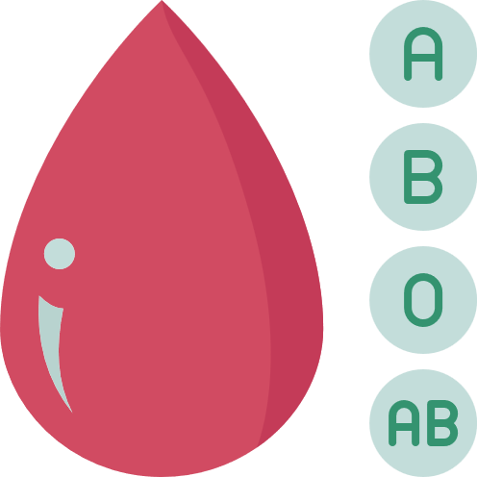

BLOODBANK MANAGEMENT AND SUPPLYCHAIN TRANSPARENCY USING BLOCKCHAIN
MAJOR PROJECT
PROJECT GUIDE
MR . VAZIUDDIN

Slide 2

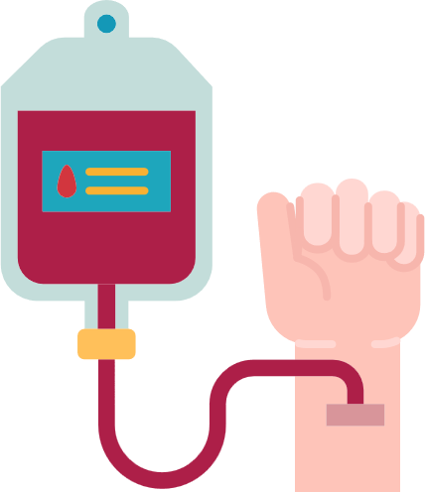
01.
ABSTRACT
02.
OBJECTIVES
03.
PROPOSED SYSTEM
04.
LITERATURE SURVEY
05.
IMPLEMENTATION
06.
PRESENT STATUS
07.
CONCLUSION
TABLE OF
CONTENT

Slide 3


OUR TEAM
01.
M.JASWANTH
20R21A6218
02.
M.VENKATA SAI KUMAR
20R21A6225
03.
M.SRI RAM CHARAN
20R21A6228

Slide 4
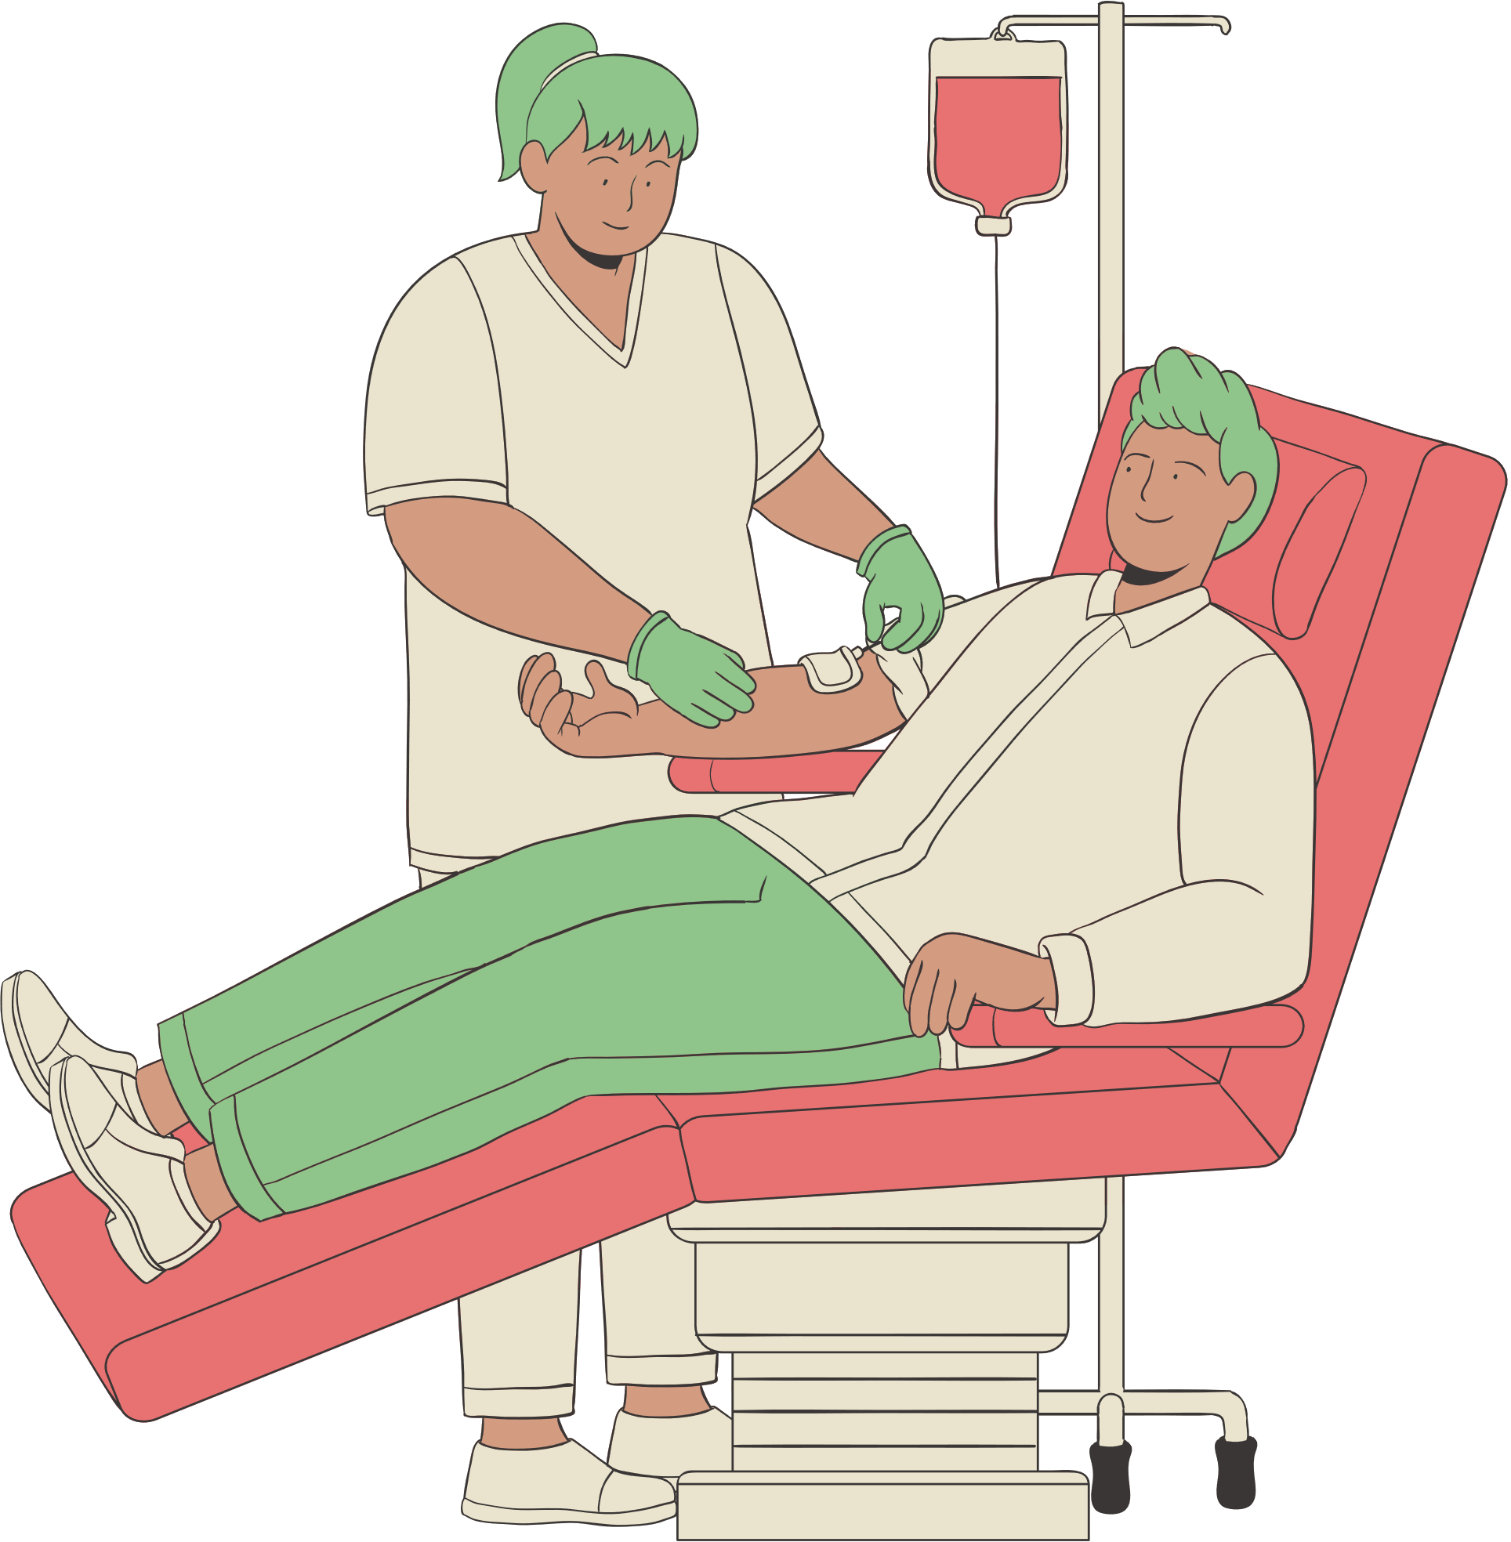
ABSTRACT
The blockchain-based blood supply chain management system is a transformative solution designed to address critical challenges in the blood distribution process. Leveraging the transparency, security, and efficiency of blockchain technology, this system provides an innovative approach to ensure safe and timely delivery of blood products.
It enhances traceability, minimizes fraud, and improves the overall transparency of the blood supply chain. By enabling real-time monitoring and seamless coordination among stakeholders, this solution revolutionizes blood management, ultimately saving lives and bolstering trust in the healthcare sector.

Slide 5


OBJECTIVES
01.
TRANSPARENCY
02.
AADHAR AUTHENTICATION
03.
EFFICIENT COMMUNICATION

Slide 6

PROPOSED SYSTEM
Transparency and traceability
QR code
Credit points

Slide 7
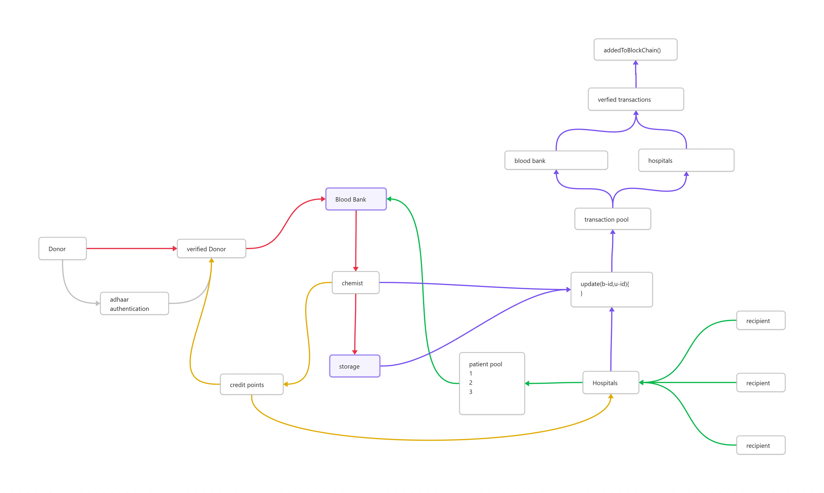
ARCHITECTURE

Slide 8
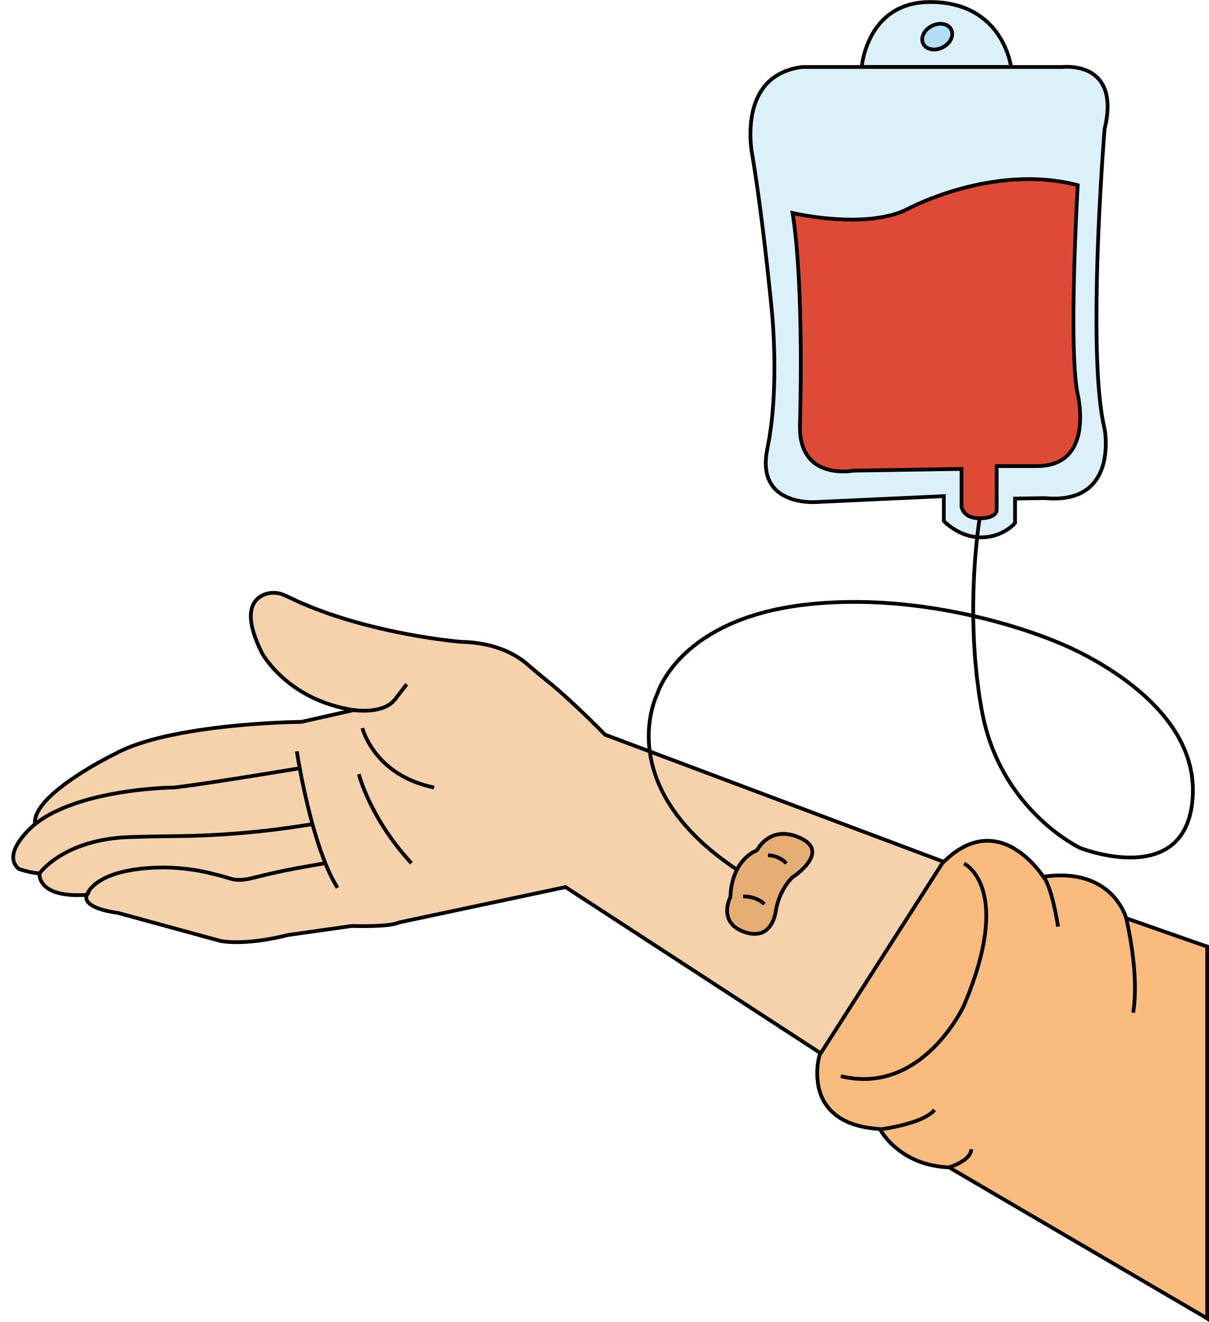
Literature Survey
Decentralized based blood supply chain management.
Ethereum powered automated blood management system.
Blood donation registry by integrating.

Slide 9
PRESENT STATUS

Slide 10
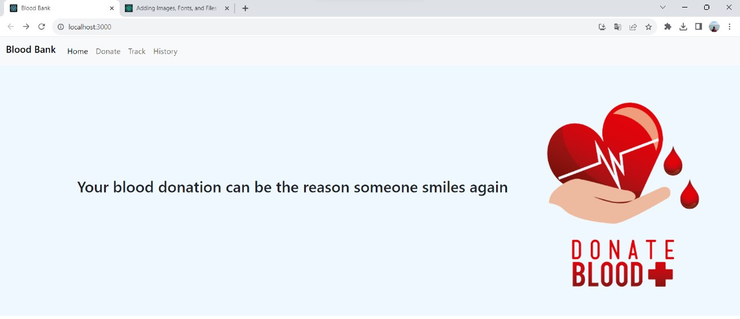
IMPLEMENTATION
FRONT-END

Slide 11
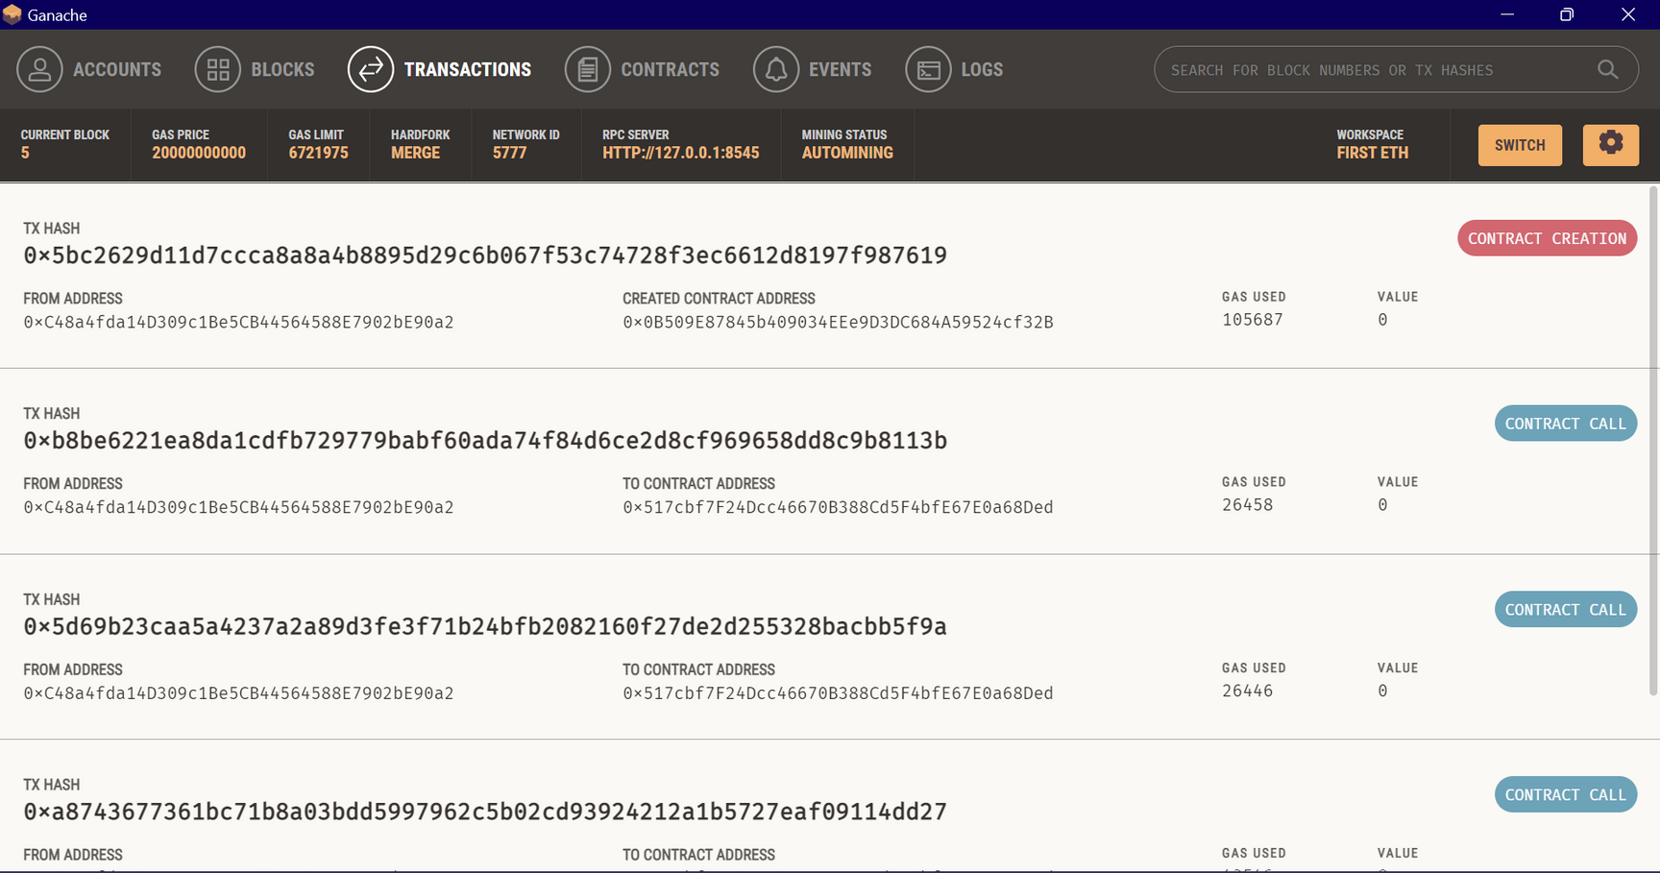
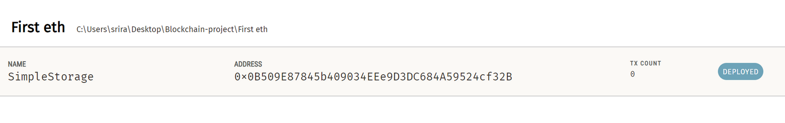
IMPLEMENTATION

Slide 12

CONCLUSION
TRANSPARENCY AND SECURITY ARE SIGNIFICANTLY ENHANCED THROUGH BLOCKCHAIN'S TAMPER-PROOF LEDGER.
REAL-TIME MONITORING AND TRACKING OF BLOOD PRODUCT TRANSACTIONS STREAMLINE THE ENTIRE DISTRIBUTION PROCESS.
THE SYSTEM REDUCES THE RISK OF FRAUD, ENSURING THE SAFETY AND AUTHENTICITY OF BLOOD PRODUCTS.
TRUST AMONG STAKEHOLDERS IN THE HEALTHCARE INDUSTRY IS STRENGTHENED BY THE INCREASED TRANSPARENCY AND INTEGRITY OF THE SUPPLY CHAIN.
THE IMPLEMENTATION OF BLOCKCHAIN TECHNOLOGY OFFERS THE POTENTIAL TO REVOLUTIONIZE HEALTHCARE BY IMPROVING THE QUALITY OF CARE.

Slide 13

THANK YOU

